Slide 1

R&D Expense Strategy
Vanesa Alcantara - Jordan Ehlinger

Slide 2


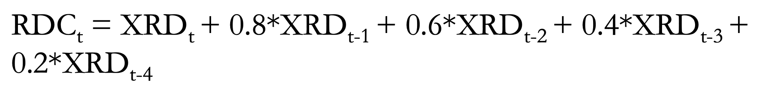
Definition of Terms
Weighted R&D:
RDC/ME is the final sorting variable. ME is the year-end market cap for the security at time t. RDC is weighted moving average of yearly R&D spend. Time t is the year prior to the monthly returns we are tracking. For example, if I am forming my portfolio for 1980 and will track the monthly returns for 1980 then t=1979. Hence RDC/ME represents a firm’s R&D expenditure weighted by the size of the company.
CAPM: R_{Port} - R_{f} =α +β(R_{Mkt} –R_{f})
CAPM alpha represents portfolio return after adjusting for systematic risk.
Fama-French 3-Factor: R_{Port} - R_{f} =α +β(R_{Mkt} -R_{f})+βSMB +βHML
Fama French alpha represents portfolio return after adjusting for size, book-to-market, and systematic risk (see next slide).
Equal Weighting : The total monthly return is the average of the monthly returns of all the firms in the portfolio that month.
Value Weighting: The total monthly return is the sum of all the weighted returns of all the firms in the portfolio that month, where weight is determined by the ratio of the security's mkt cap to total mkt cap for that month.
Top 1K Firms: Determined by year-end market cap for the year prior to the monthly returns we are tracking.

Slide 3
Definition of Terms continued
Average Return: Arithmetic mean
Long Short Portfolio: Subtracted monthly returns for the Low Quintile portfolio from the monthly returns for the High Quintile portfolio. Filtered the portfolio to only include returns between 1981-07-01 – 2012-12-31.
Sharpe Ratio: Monthly S.R. = Average monthly returns of the long short portfolio divided by the standard deviation of those monthly returns. To annualize multiply by the square root of 12.
CAPM Regression: Ran an OLS regression with the Fama-French Mkt-RF monthly returns as the independent variable and long short portfolio monthly returns as the dependent variable
FF3F Regression: Ran an OLS regression with Fama French Mkt-RF, SMB (Small Minus Big), and HML (High Minus Low) monthly returns as the independent variables and long short portfolio monthly returns as the dependent variable
SMB & HML: SMB evaluates company size based on market capitalization and HML evaluates the book-to-market (BTM) ratio of companies where companies with a high BTM ratio are viewed as value stocks and companies with a low BTM ratio are growth stocks.
BTM: Book value is calculated by the company's assets minus its liabilities while market value is calculated by multiplying the number of shares outstanding by the share price.

Slide 4
Assignment 1 Overview
Hypothesis: Firms that have more ‘R&D capital’ relative to their market caps should have high future returns; therefore, a long short portfolio where we buy high ‘weighted R&D’ firms and sell low ‘weighted R&D’ firms should outperform the benchmark portfolios (CAPM and Fama-French 3-Factor)
Process: Separate firms with R&D expenditure into quintiles sorted by ‘weighted R&D’. Create singular portfolio for firms with no R&D expenditure. With these six portfolios follow the process outlined below.
Equal-Weighted Portfolios
Value-Weighted Portfolios
Minus Top 1K Firms (VW)
Quick and easy to formulate for capturing the average monthly returns of my portfolios
Effect is stronger among small firms, and we do not want major market players to influence the results
Avoid monthly rebalancing bias and small stocks dominating excess returns

Slide 5
Summary
We were able to reach convergence across each group of portfolios
Average returns follow similar trend in each portfolio that is seen in the provided results
Similar growth in average returns between quintiles when compared to the provided results
Value weighted and value weighted minus top 1000 firms both generated similar alphas and Sharpe Ratios compared to the provided results
Key Differences
Consistently higher average returns
Equal weighted alphas and Sharpe Ratio overperformed compared to provided results
Theories:
Exclusion of pharmaceutical companies
Exclusion of outlying monthly returns (low and high end)
Filtering of certain exchanges
Exclusion of smallest market caps

Slide 6
Convergence Process
Verified that csv inputs align
Aligned data cleaning (fill NaNs, market cap one month shift, removing monthly return outliers) and filtering (fic, sic, exchange)
Reverted to same data lagging process
Utilized same function to split portfolio into the quintiles
Adjusted filtering of Top 1K Firms to grab top market caps after the RDC_ME was calculated so we were not disrupting this function. Also, ensured the one-year shift applied to all the fundamentals data including these Top 1K firms, so they would match when merged with returns.

Slide 7
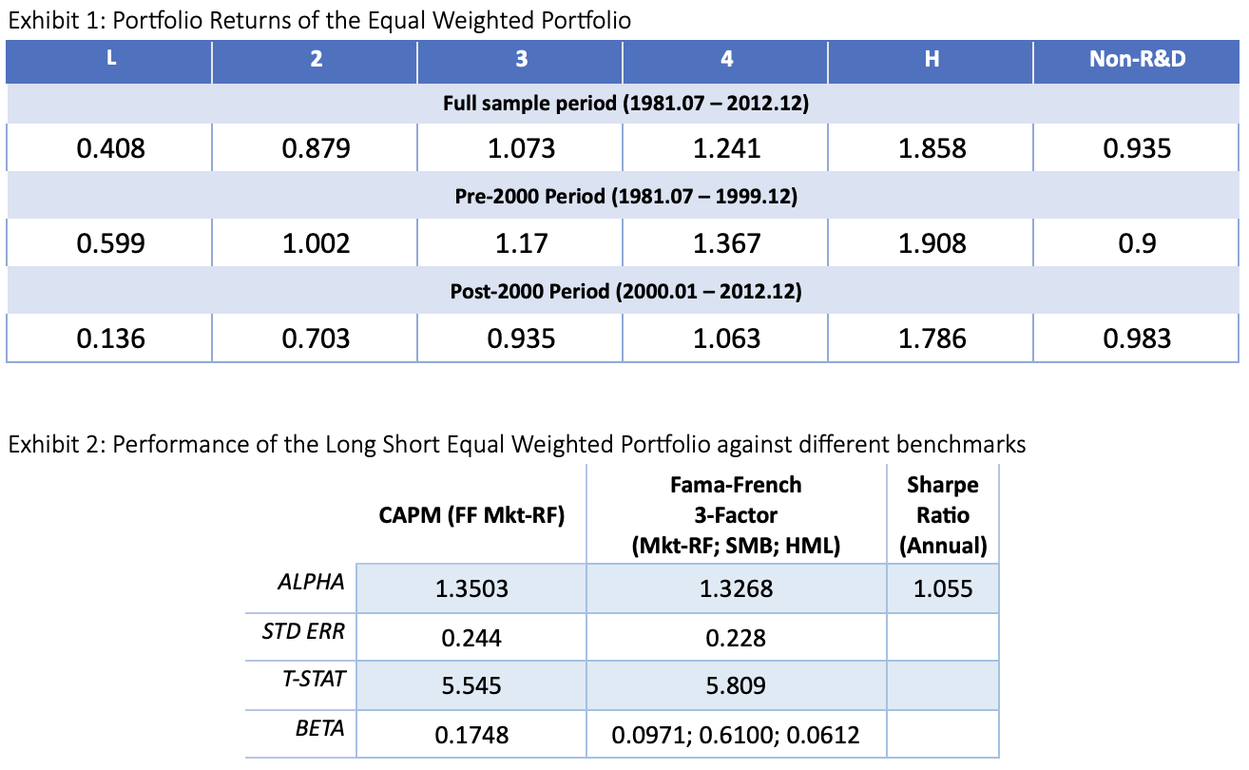
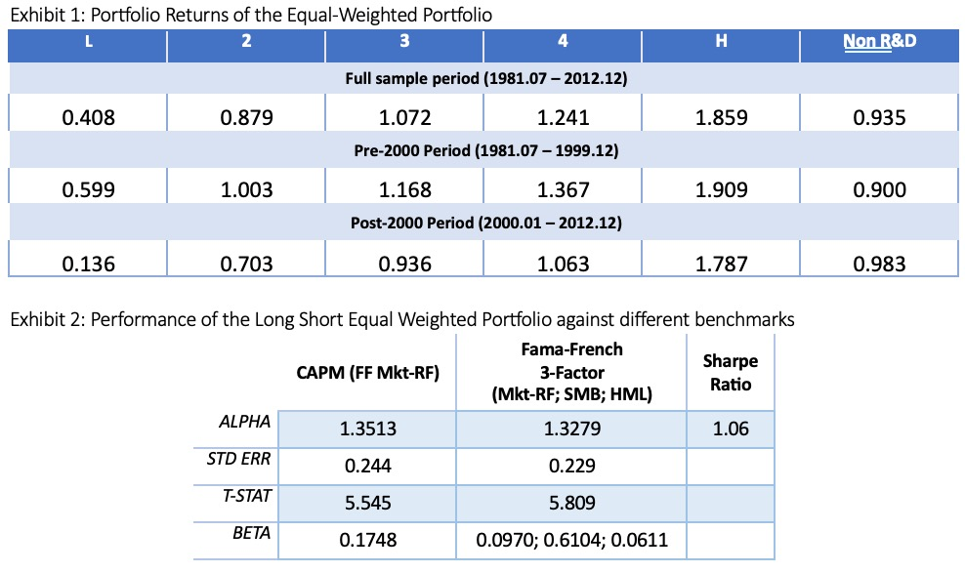
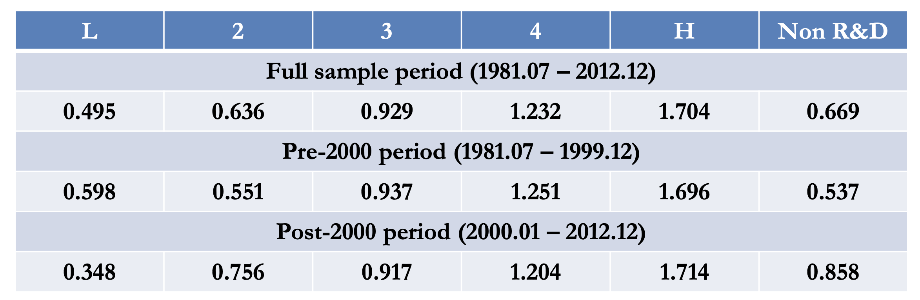
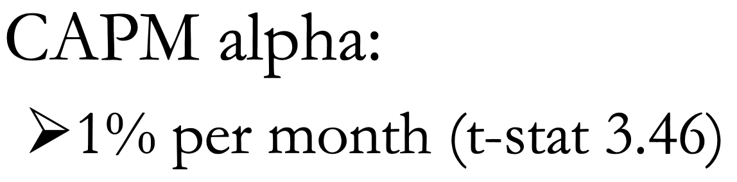
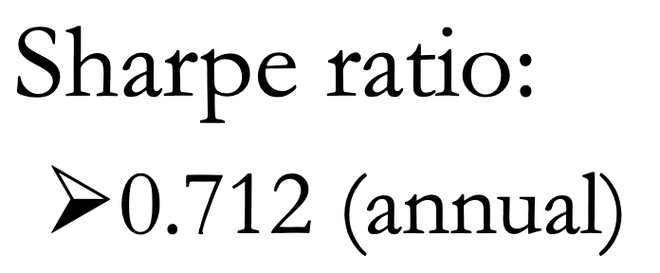
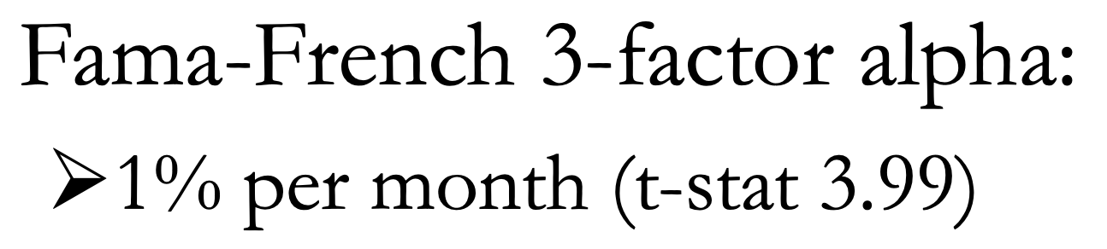
Equal Weighted Compared Results

Slide 8
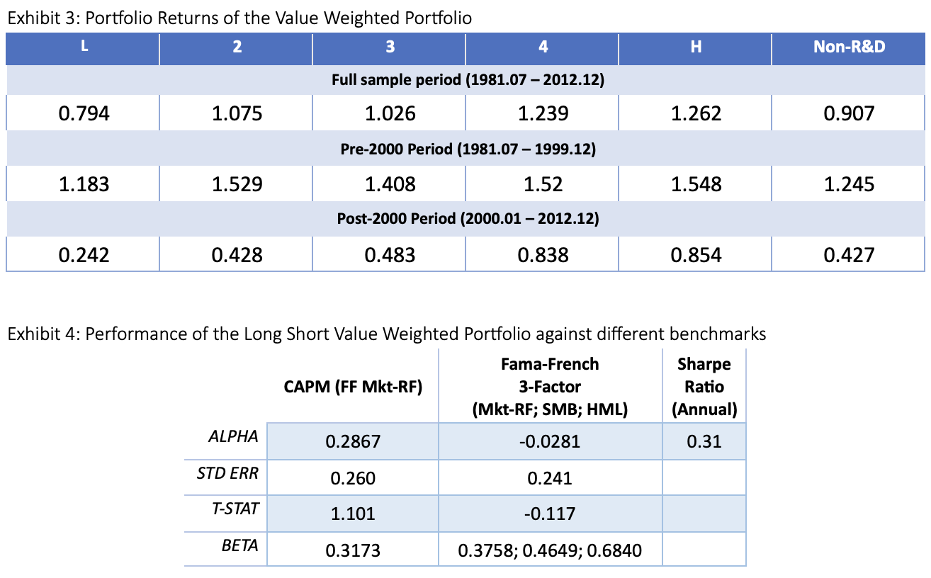
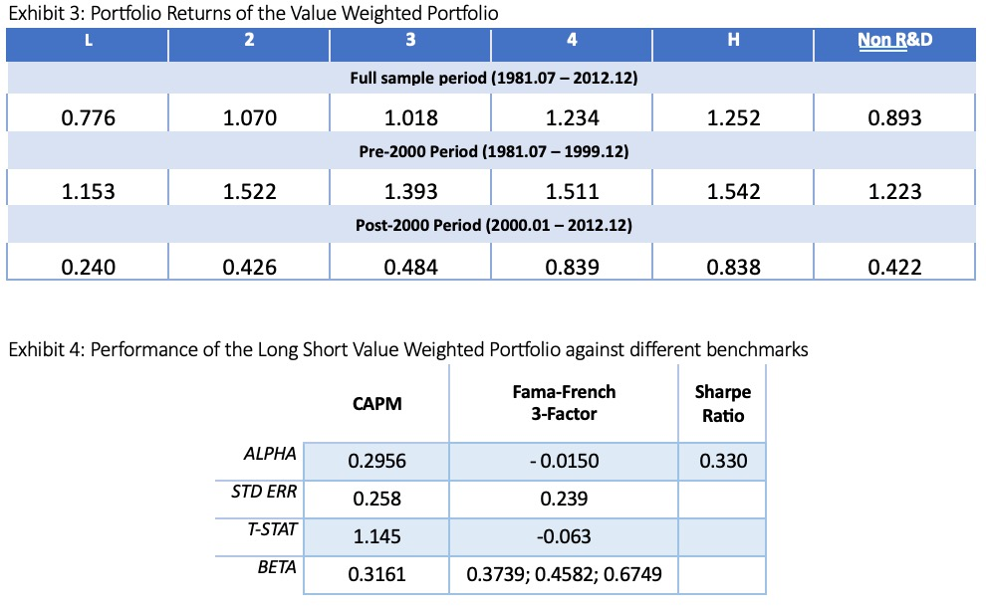
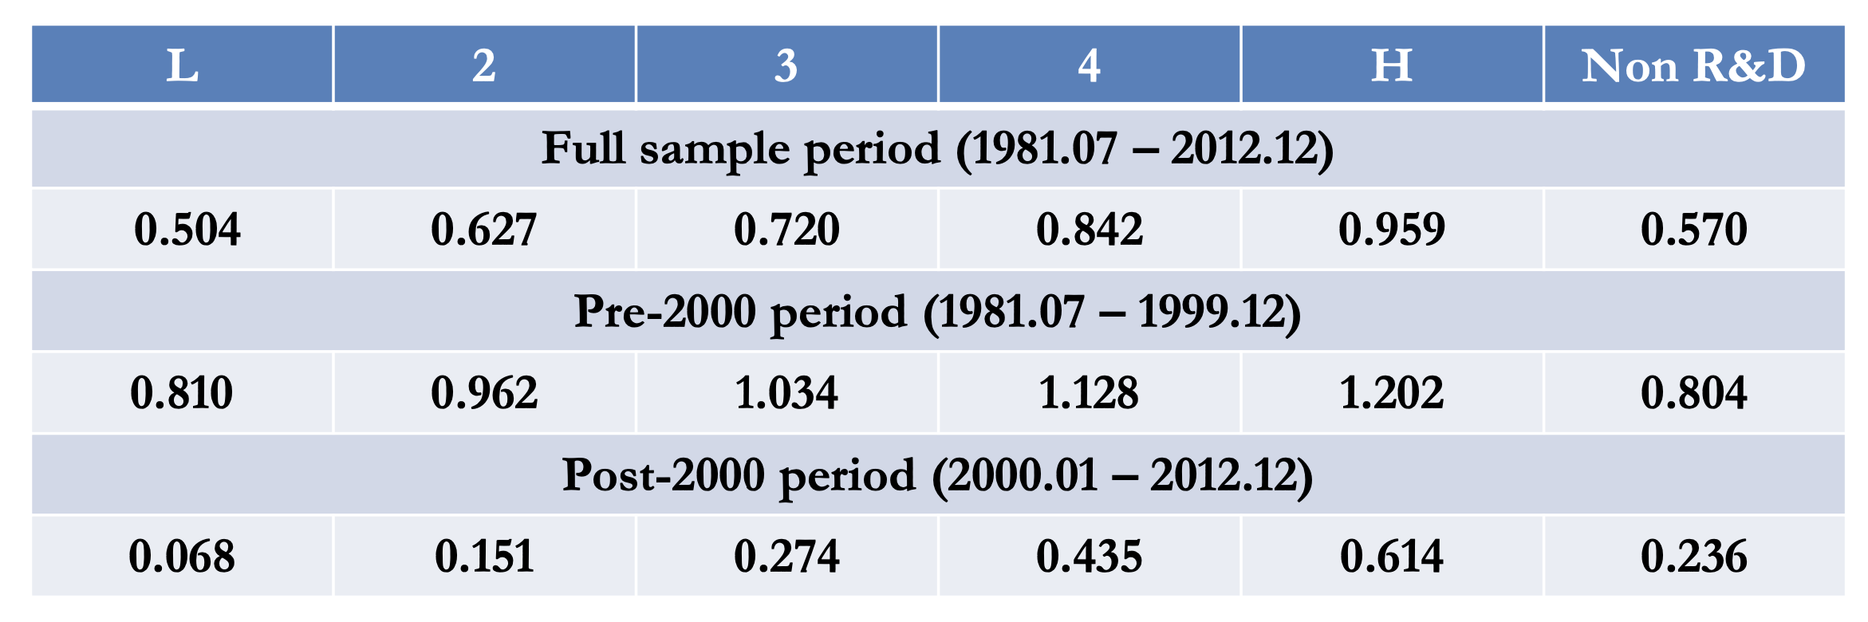
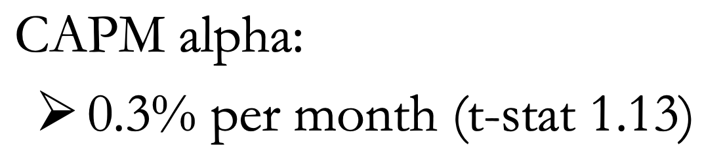
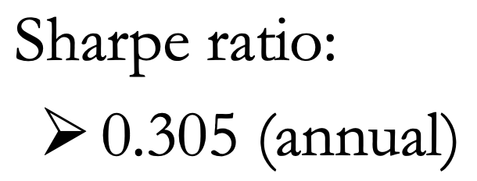
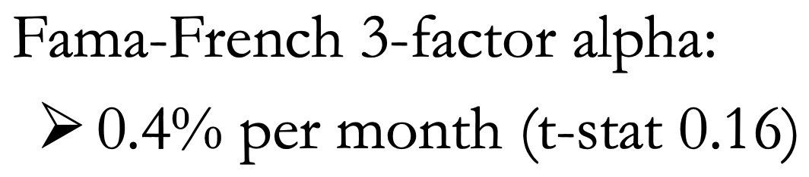
Value Weighted Compared Results

Slide 9
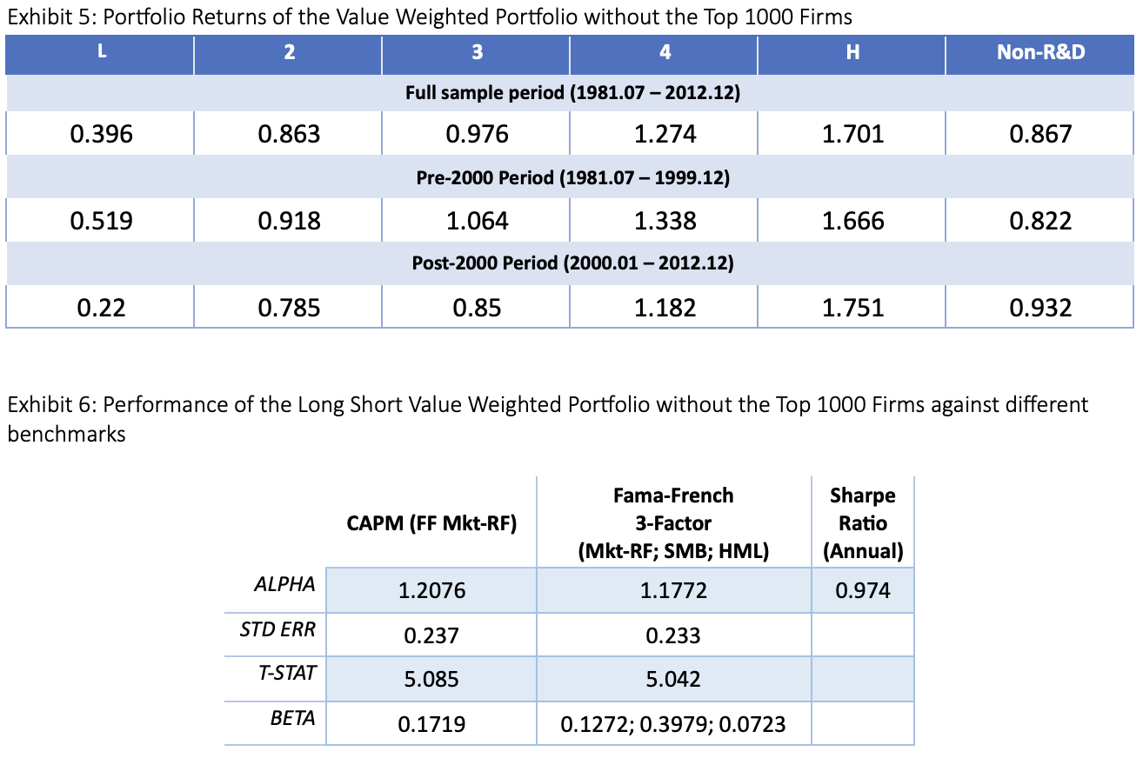
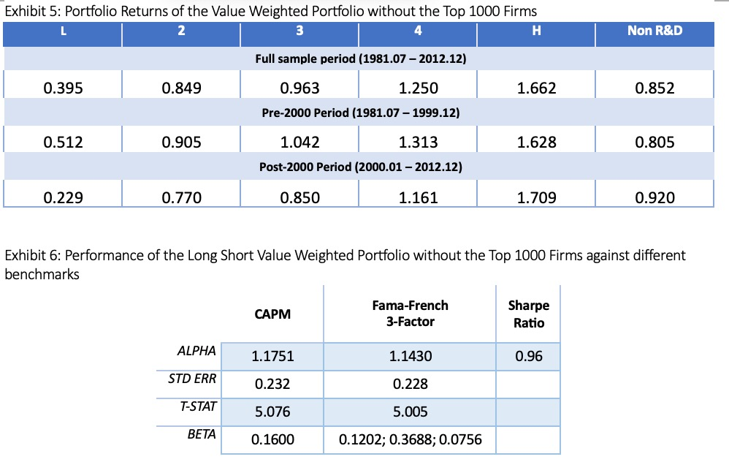
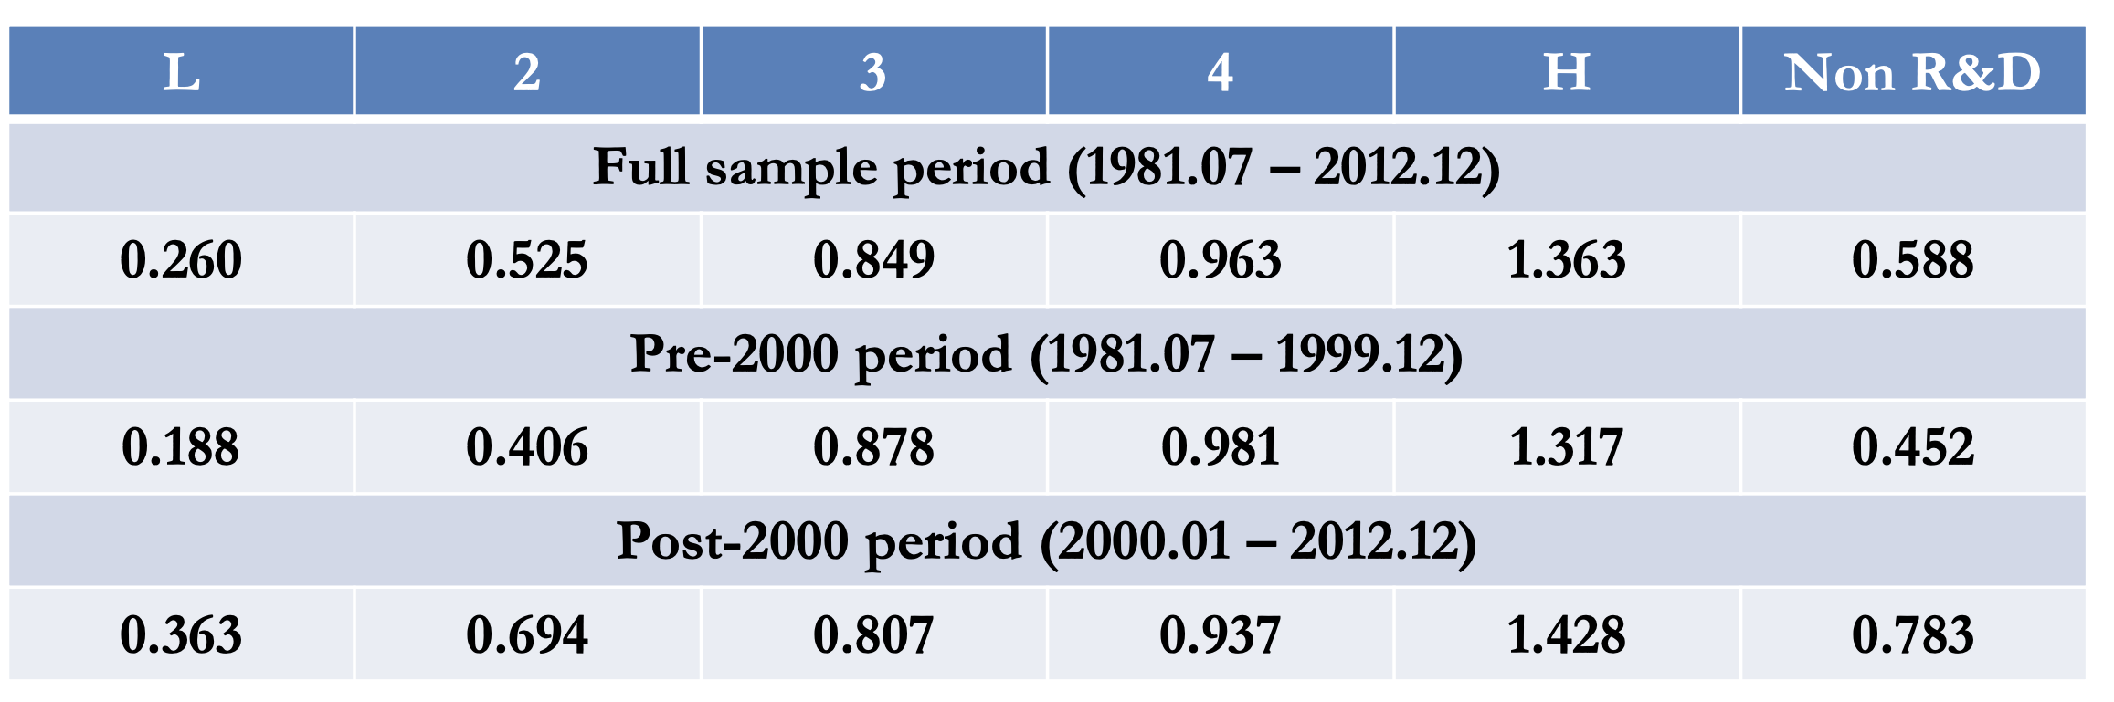
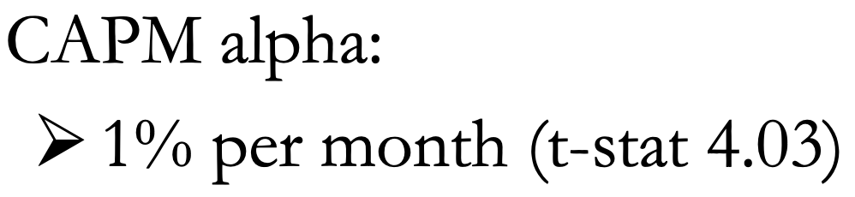
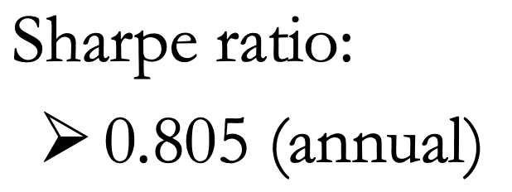
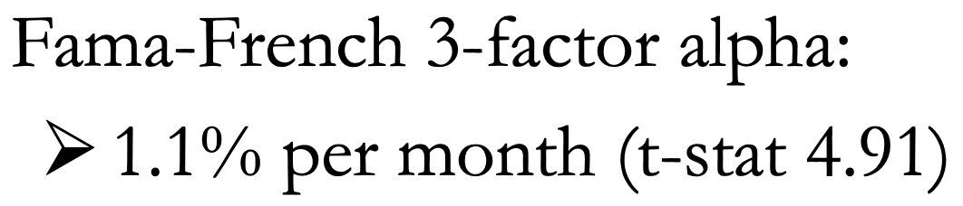
Value Weighted w/o Top 1K Compared Results

Slide 10
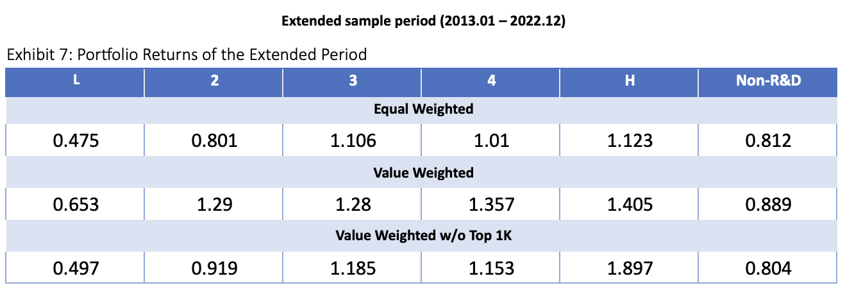
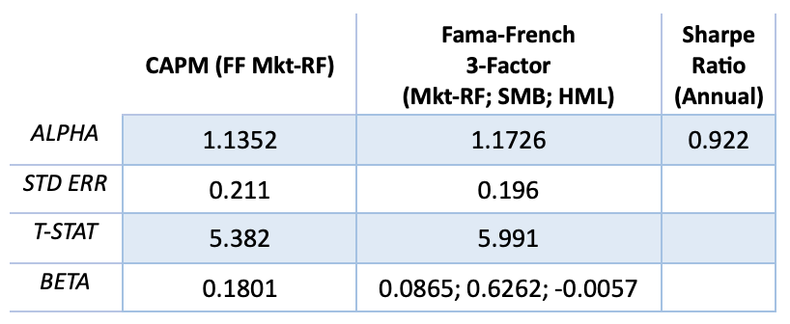
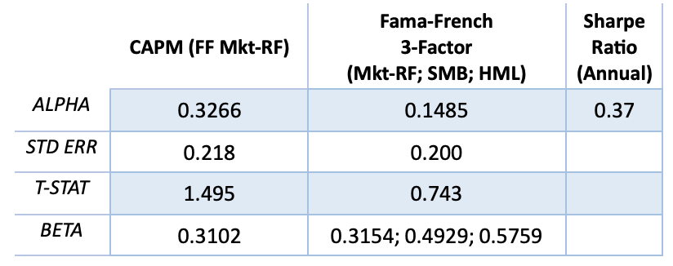
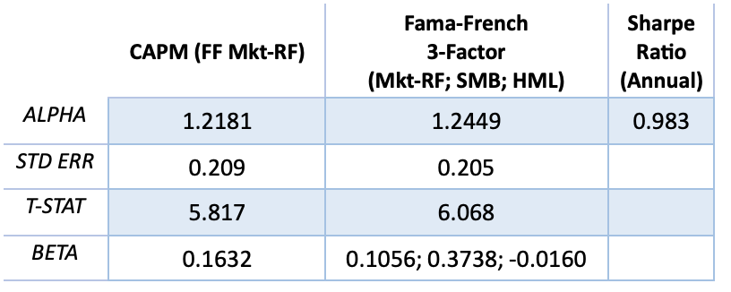
Extended Period Results
Long Short Portfolios run from 1981.07 – 2022.12
Long Short Equal Weighted Portfolio with Extended Period
Long Short Value Weighted Portfolio with Extended Period
Long Short Value Weighted Portfolio w/o Top 1K Firms with Extended Period
Jordan

Slide 11
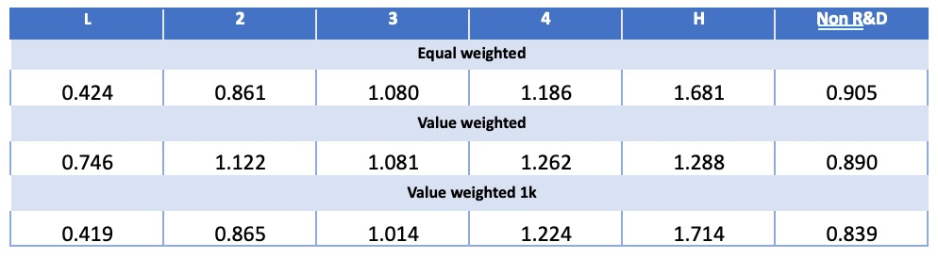
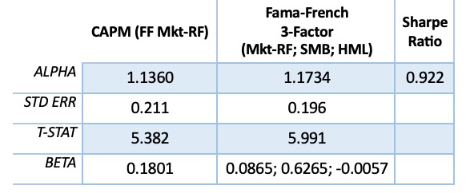
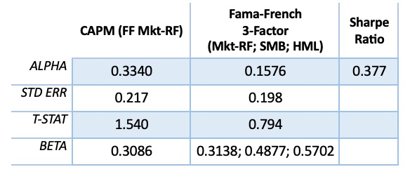
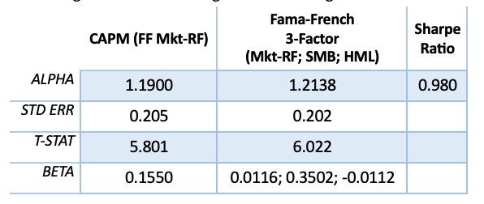
Extended Period Results
Long Short Portfolios run from 1981.07 – 2022.12
Long Short Equal Weighted Portfolio with Extended Period
Long Short Value Weighted Portfolio with Extended Period
Long Short Value Weighted Portfolio w/o Top 1K Firms with Extended Period
Vanesa

